Slide 1
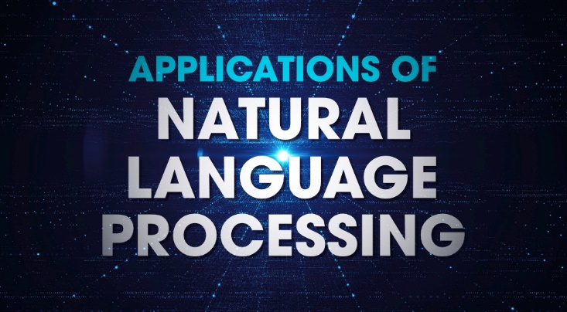

Slide 2
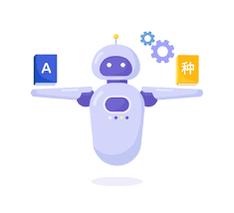
Chat botsquote Autocomplete in Search Engines Voice Assistants Language Translator Sentiment Analysis Grammar Checkers t leap for mankind.”
APPLICATIONS OF NATURAL LANGUAGE PROCESSING
- Neil Armstrong

Slide 3

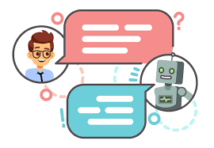
CHATBOTS
Chat bots are a form of artificial intelligence that are programmed to interact with humans in such a way that they sound like humans themselves.

Slide 4

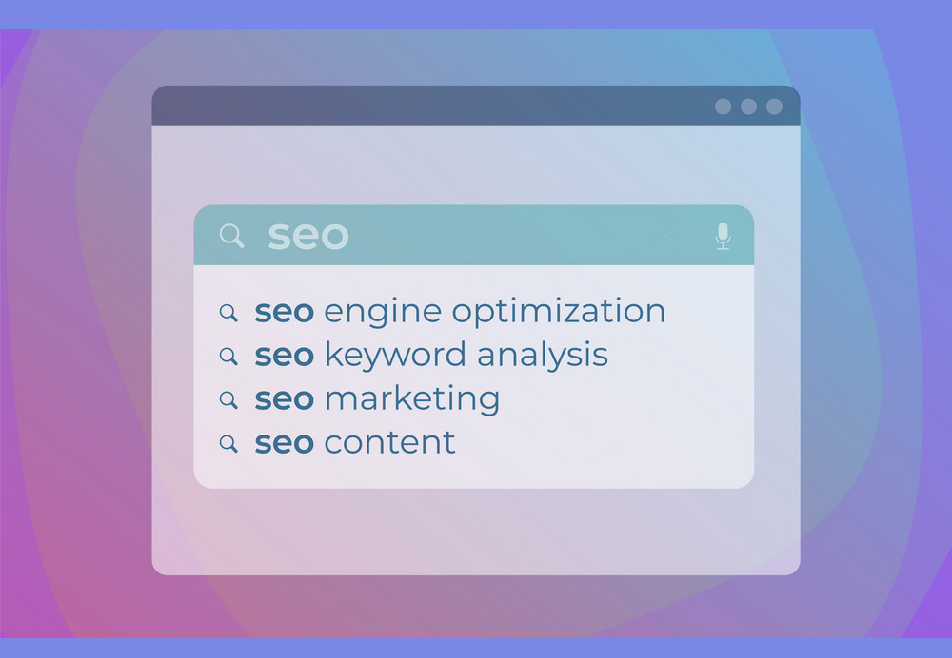
AUTOCOMPLETE IN SEARCH ENGINES
Search engines use their enormous data sets to analyze what their customers are probably typing when they enter particular words and suggest the most common possibilities.

Slide 5
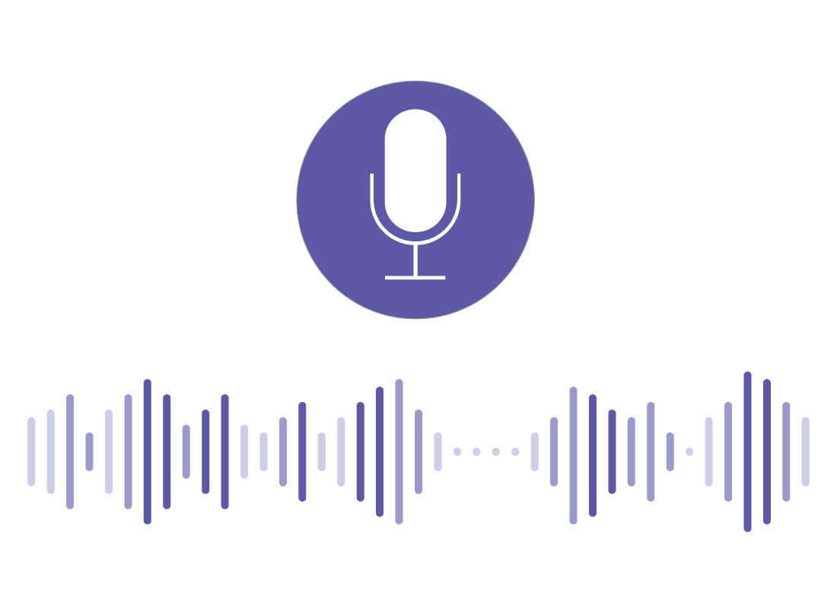
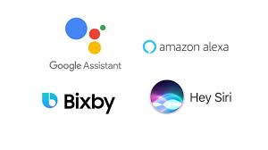
VOICE ASSISTANTS
They use a complex combination of speech recognition, natural language understanding, and natural language processing to understand what humans are saying and then act on it.

Slide 6



LANGUAGE TRANSLATOR
Allows the algorithm to convert a sequence of words from one language to another which is translation.

Slide 7
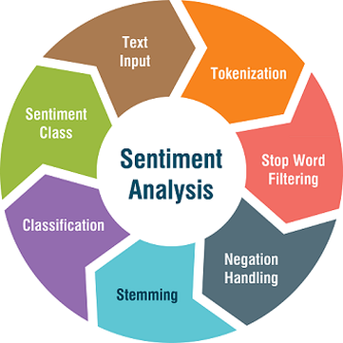

SENTIMENT ANALYSIS
Almost all the world is on social media these days! And companies can use sentiment analysis to understand how a particular type of user feels about a particular topic, product, etc. They can use natural language processing, computational linguistics, text analysis, etc.

Slide 8

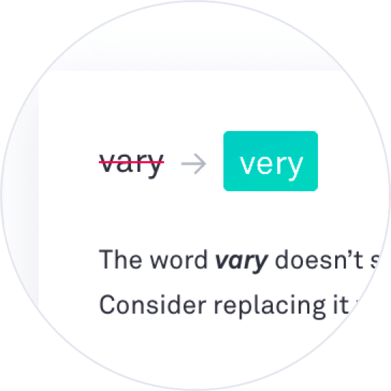

GRAMMAR CHECKERS
Grammar and spelling is a very important factor while writing professional reports for your superiors even assignments for your lecturers They can not only correct grammar and check spellings but also suggest better synonyms and improve the overall readability of your content.

